Slide 1


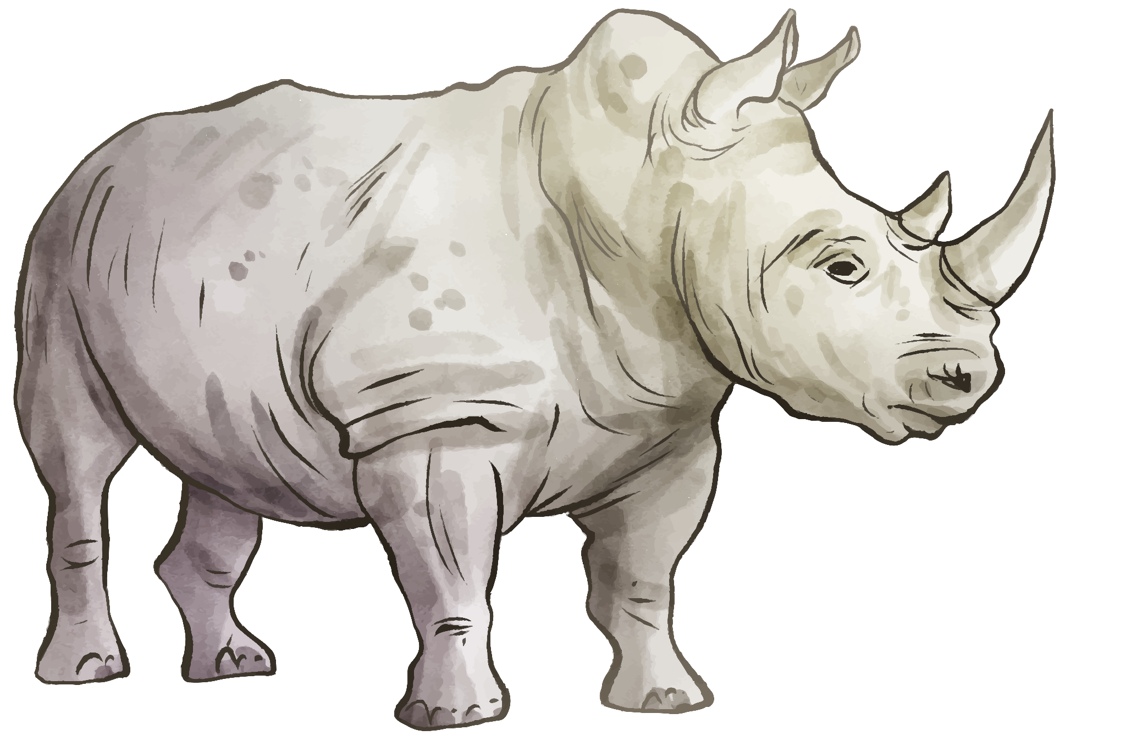
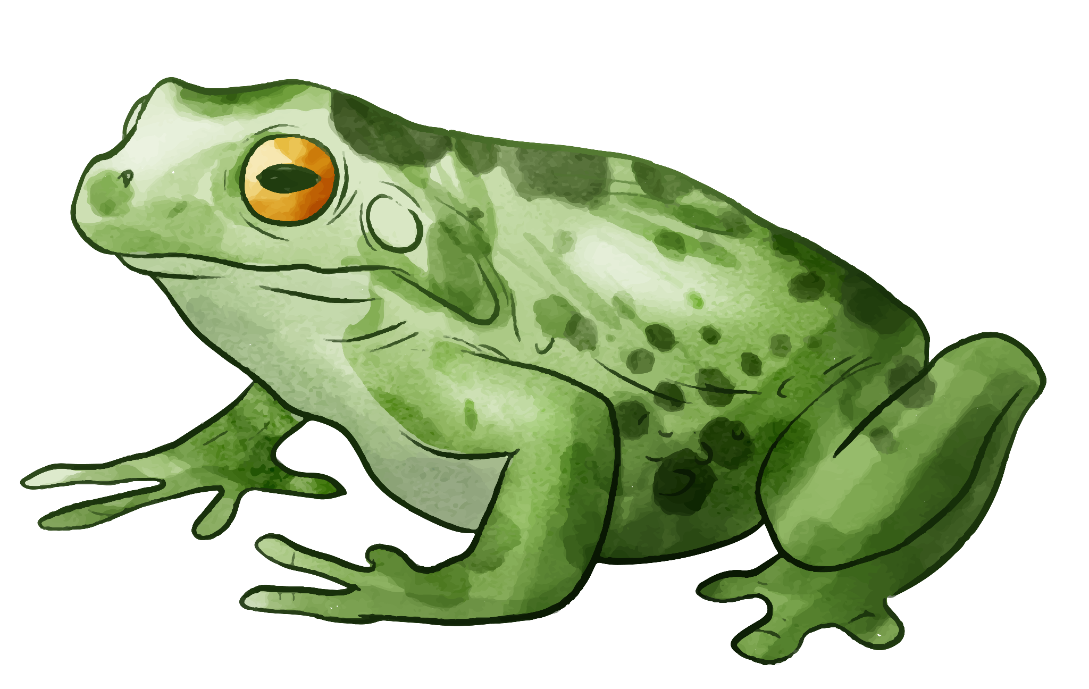


Zoo Bazaar
By Milan Milanov & Toni Hristov

Slide 2
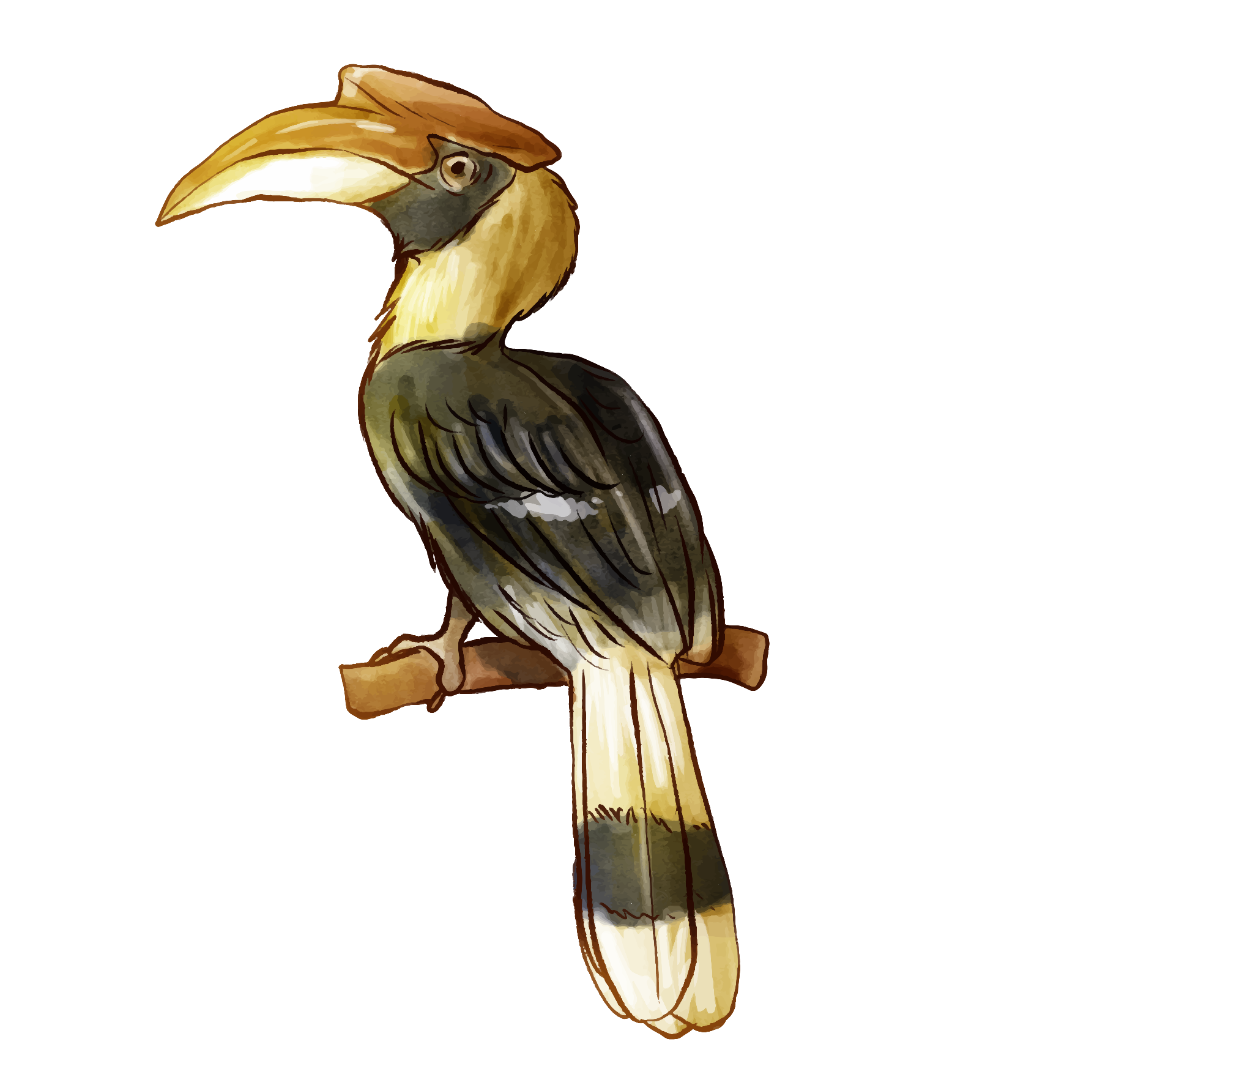
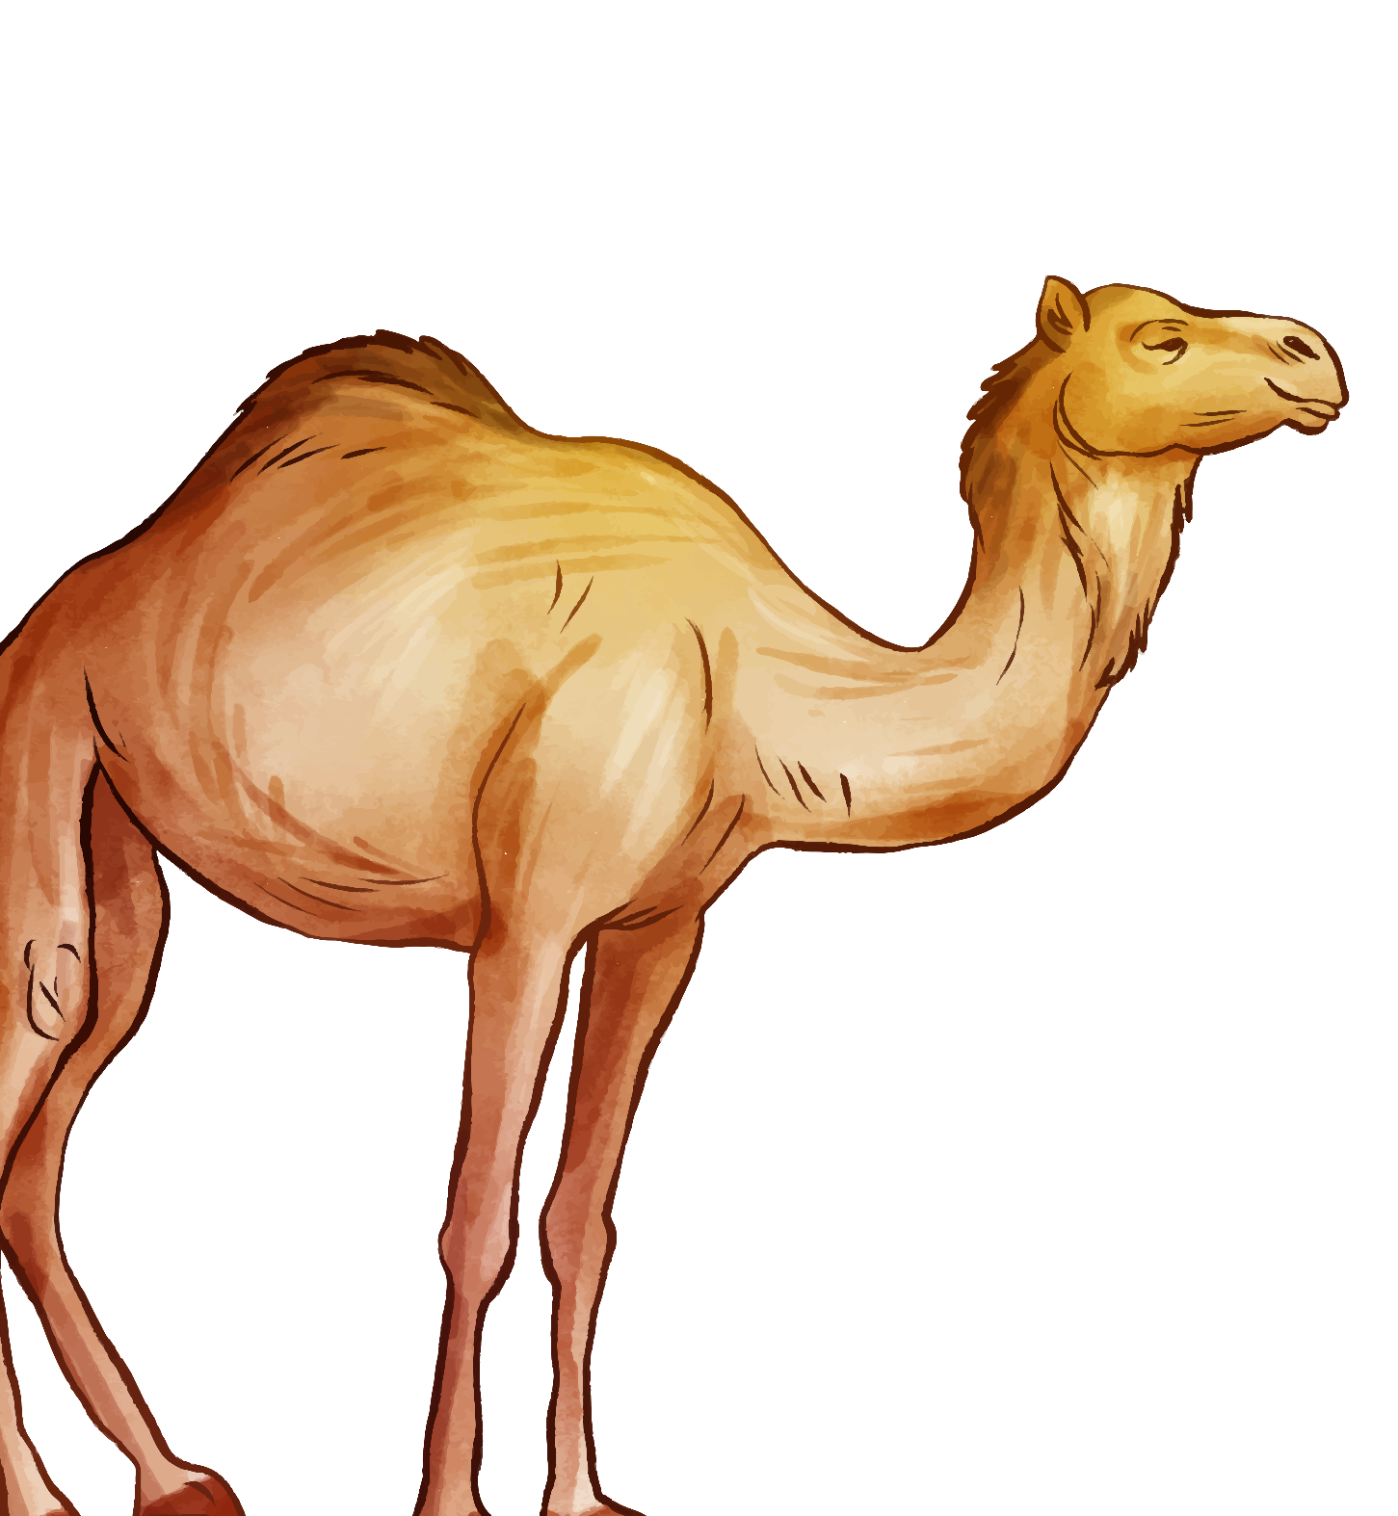


01.
Who are we?

Slide 3

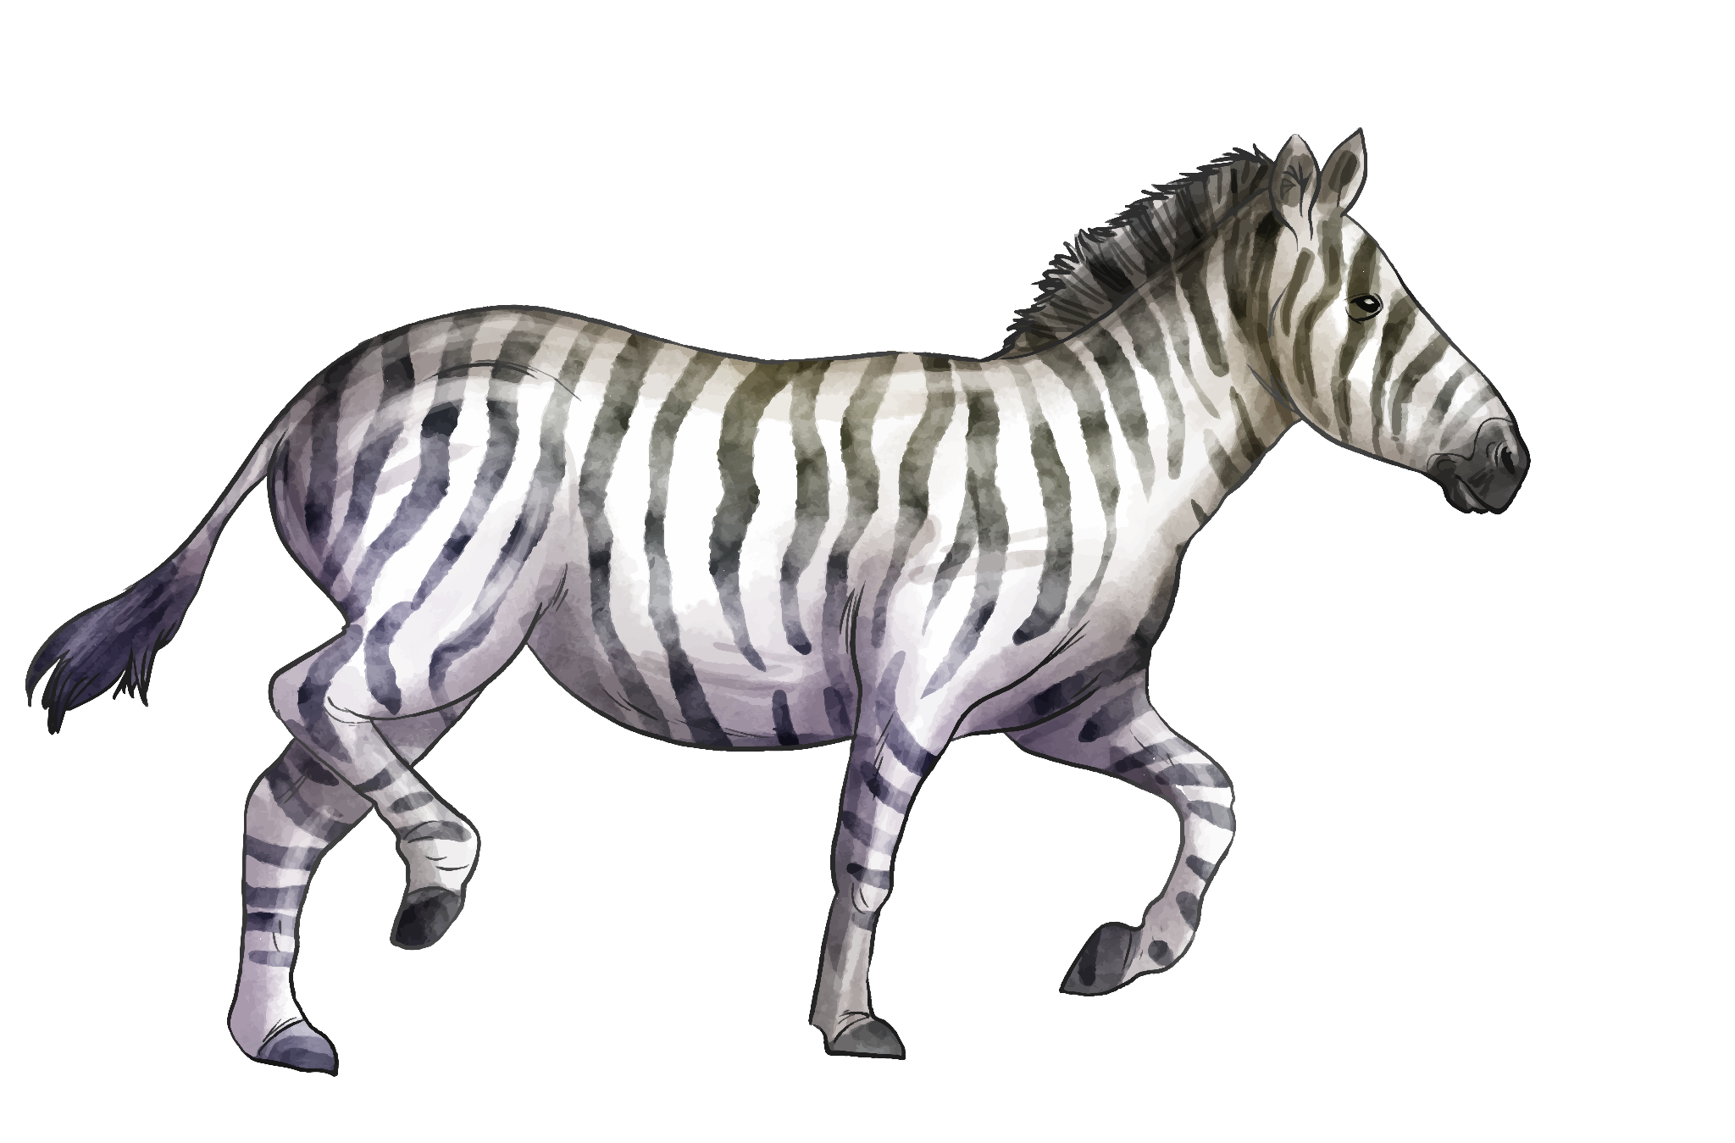
Who are we?
Meet Milan who has been instrumental in navigating the challenges we've encountered thus far in our project to develop programs for the company.
Introducing another committed member of our team, Toni, whose innovative ideas and collaborative spirit have contributed to the progress we've made.

Slide 4



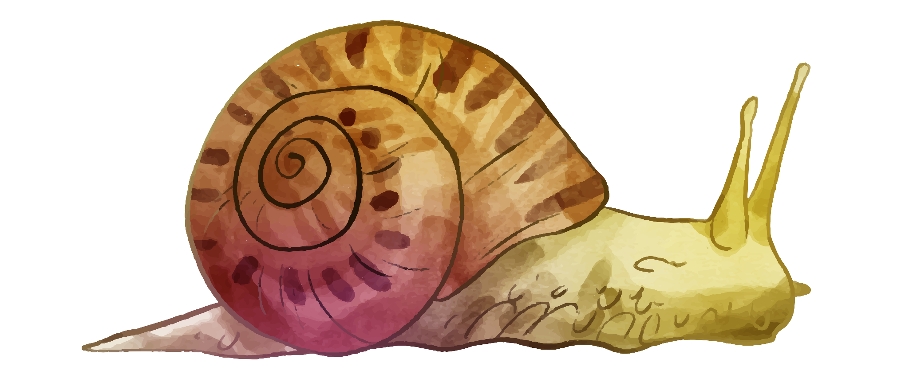
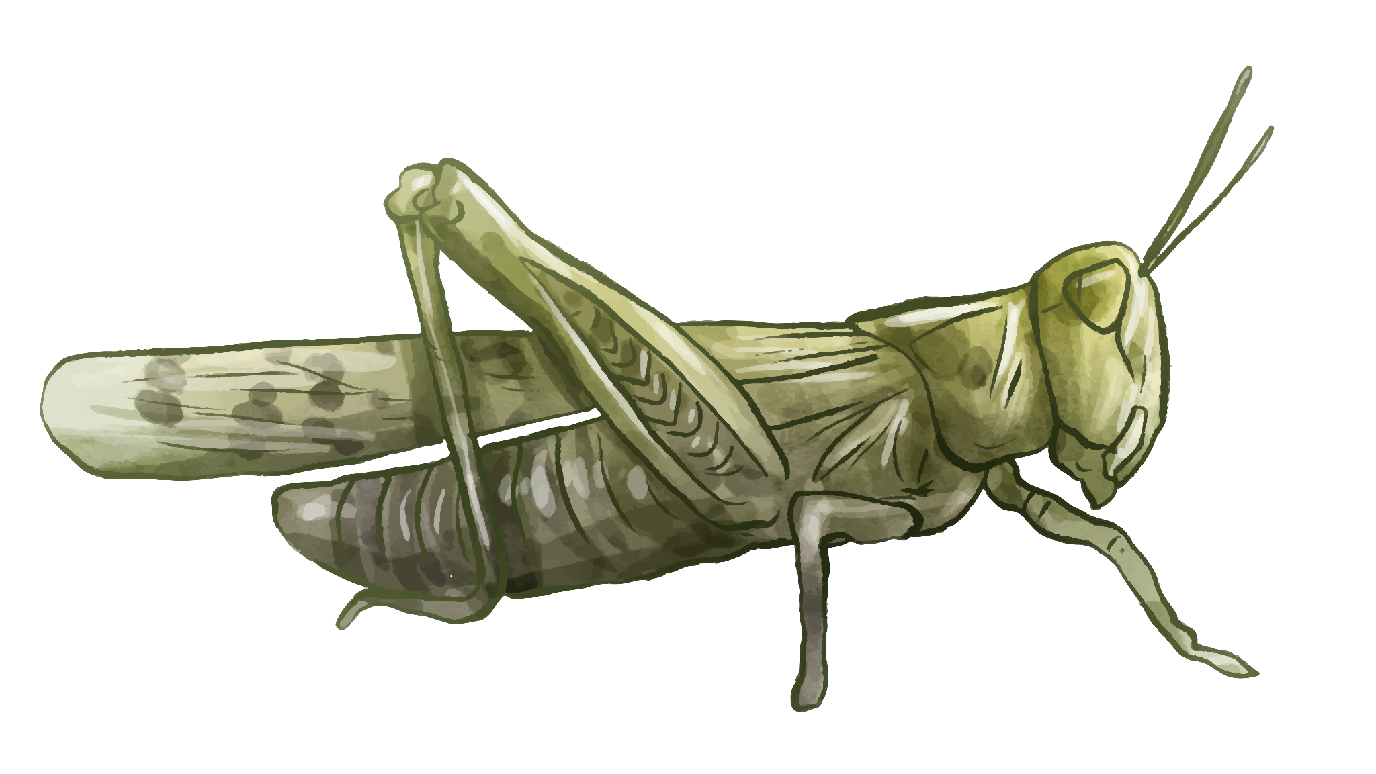
02.
Problem description

Slide 5

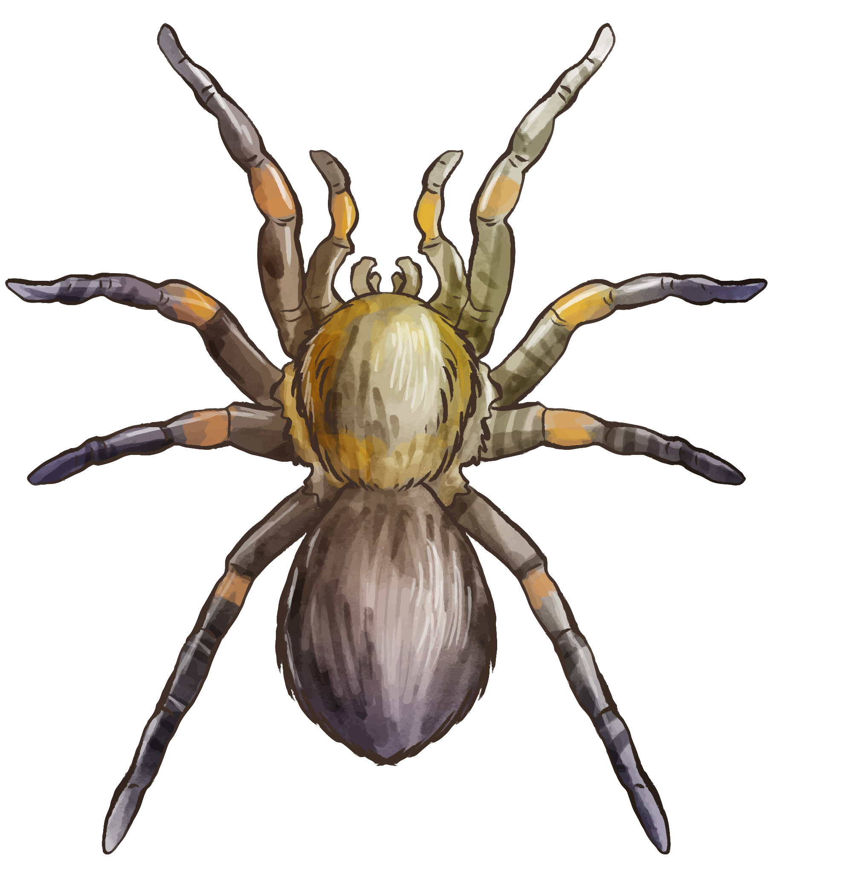
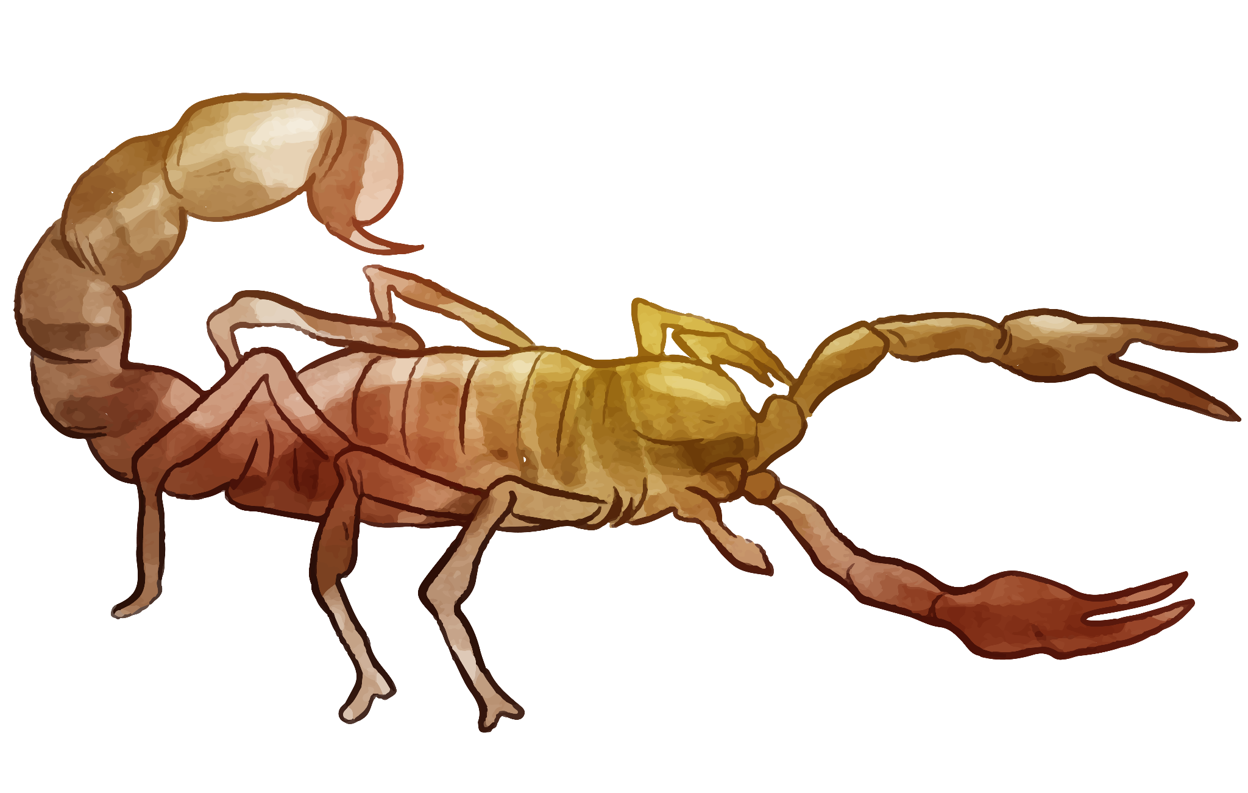
Problem description
Zoos face many day-to-day problems like taking care of animals, scheduling staff, and making visits enjoyable for people. Without a central system, tasks get harder, costing more time and money, and making visits less enjoyable. This project is about creating special software to help zoos run smoother, improve animal care, and make zoo visits better while achieving educational and conservation goals.

Slide 6
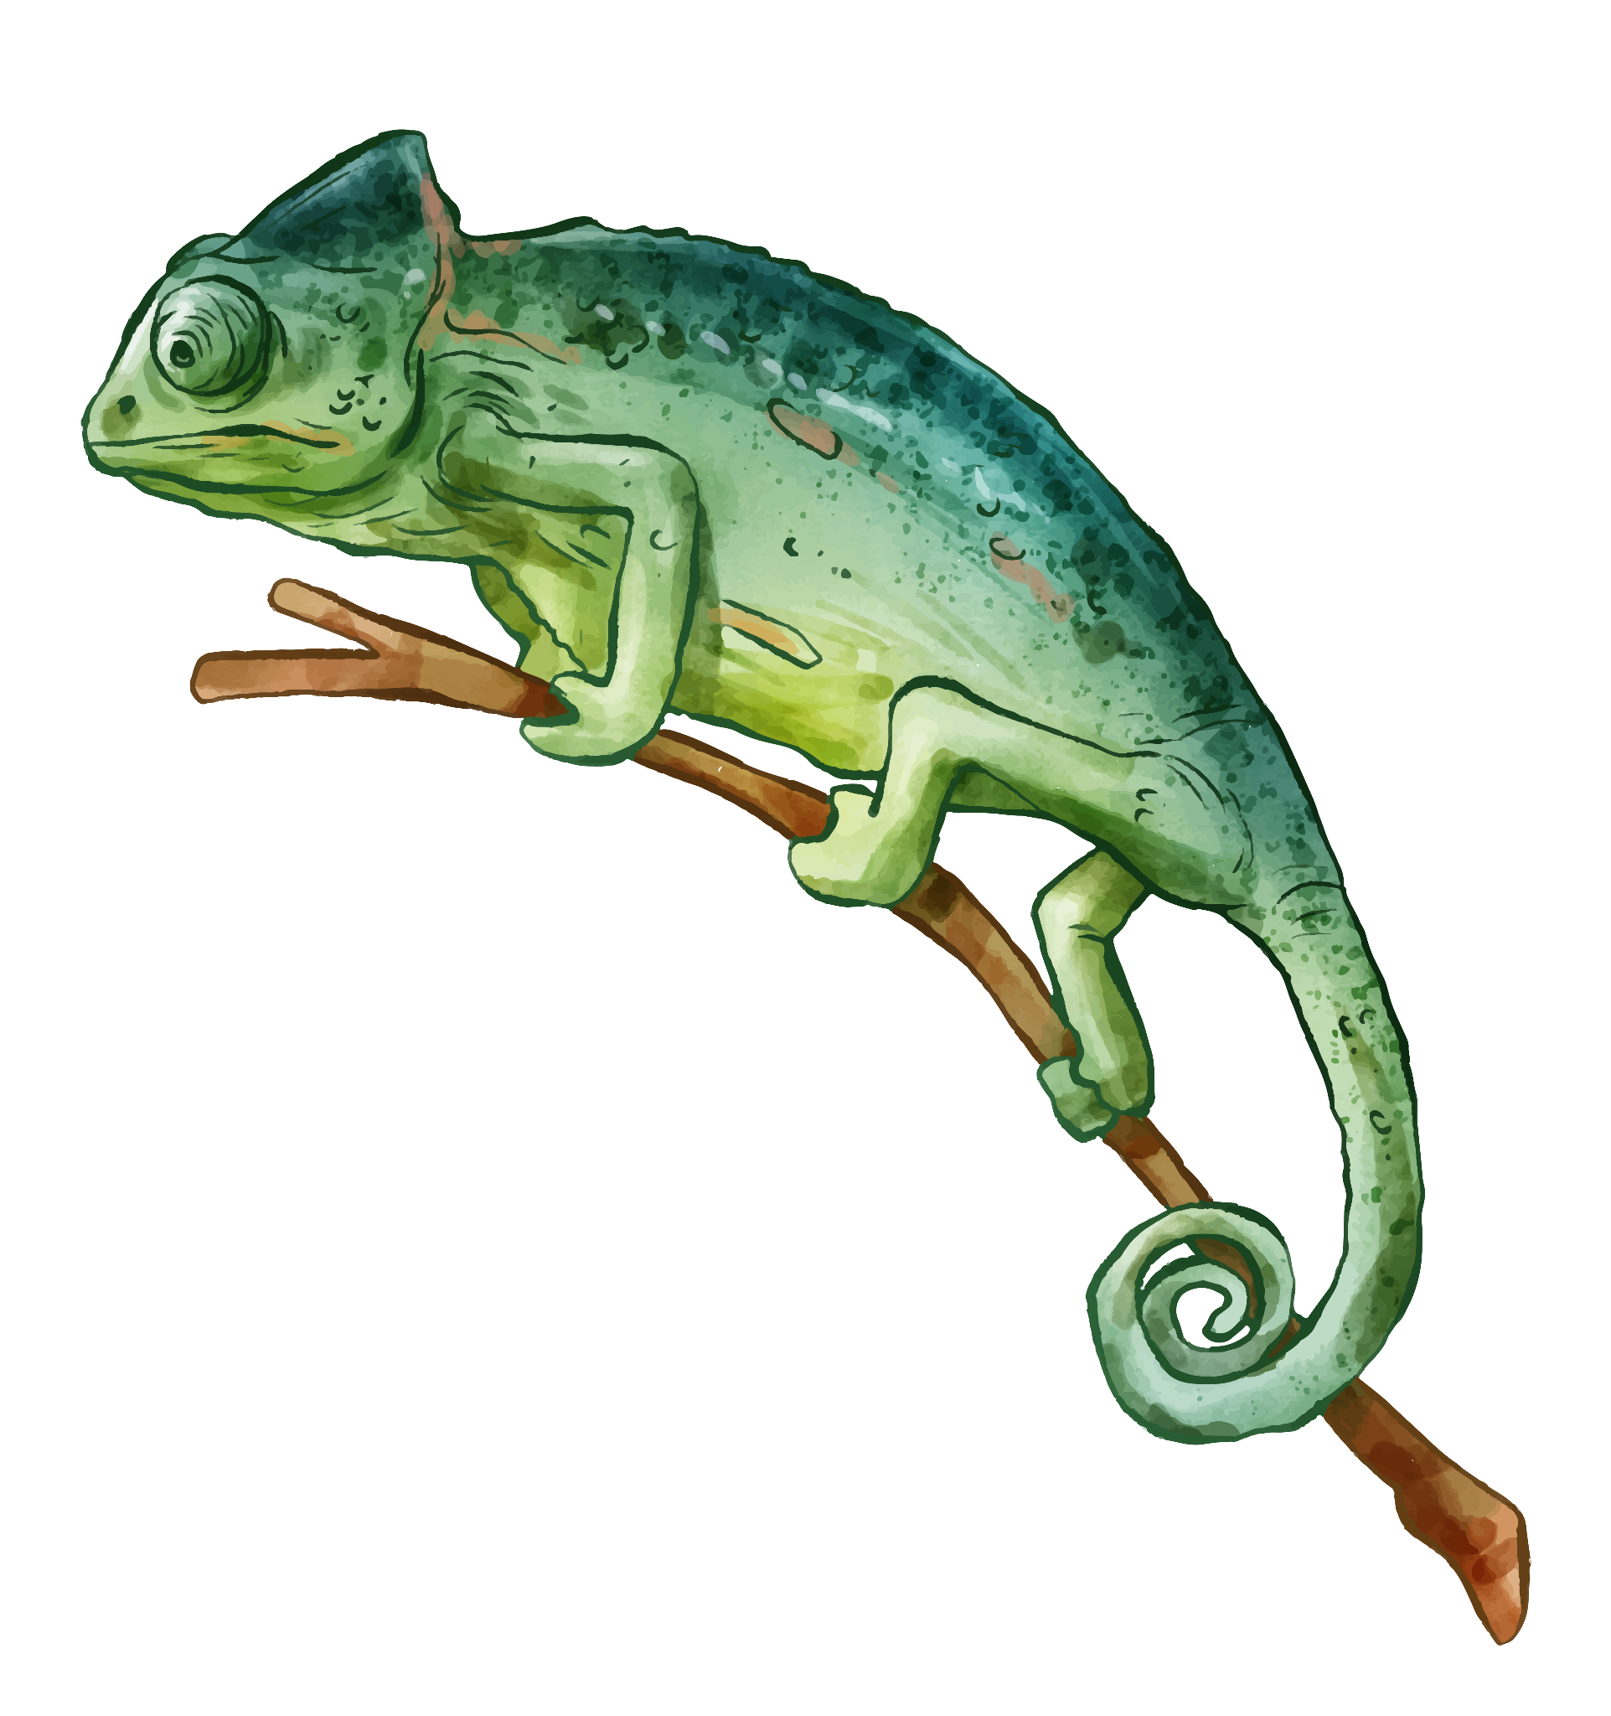
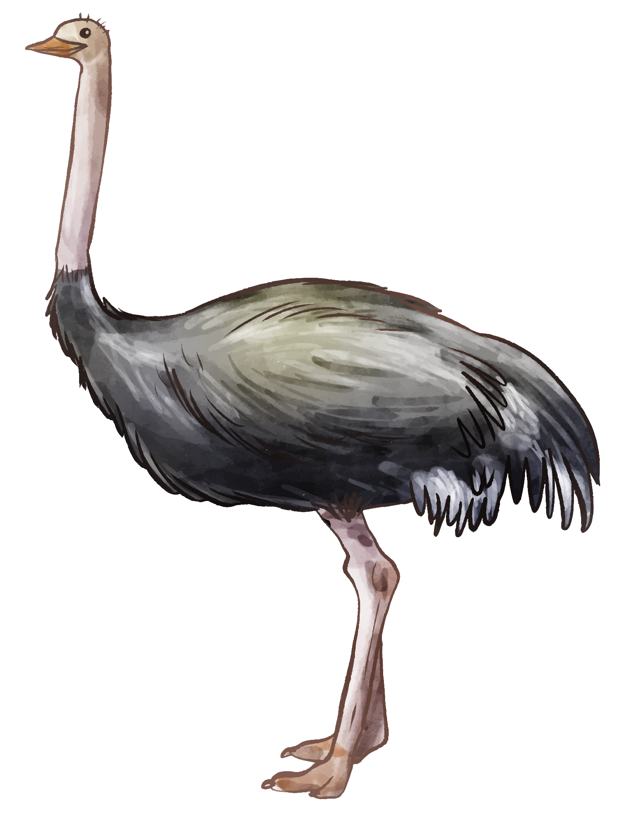
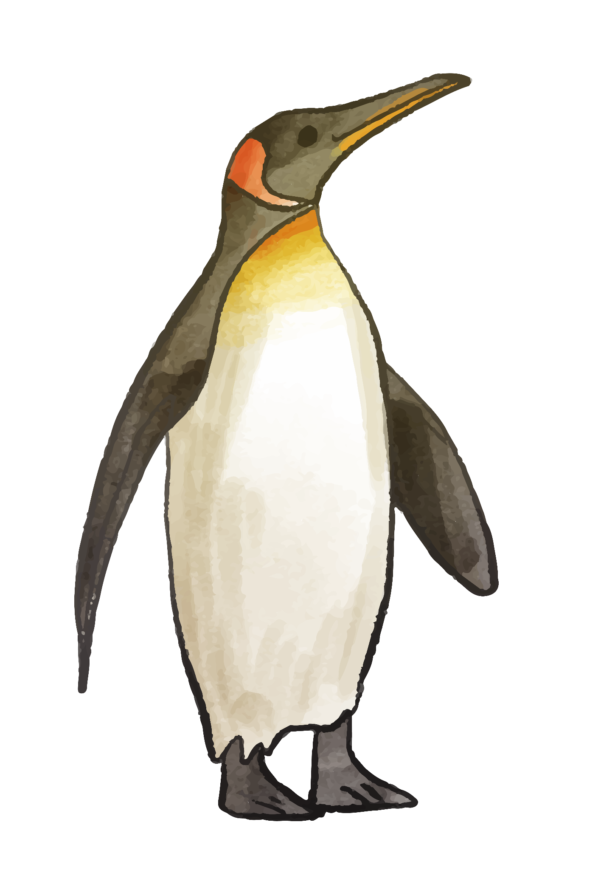

03.
Demo

Slide 7
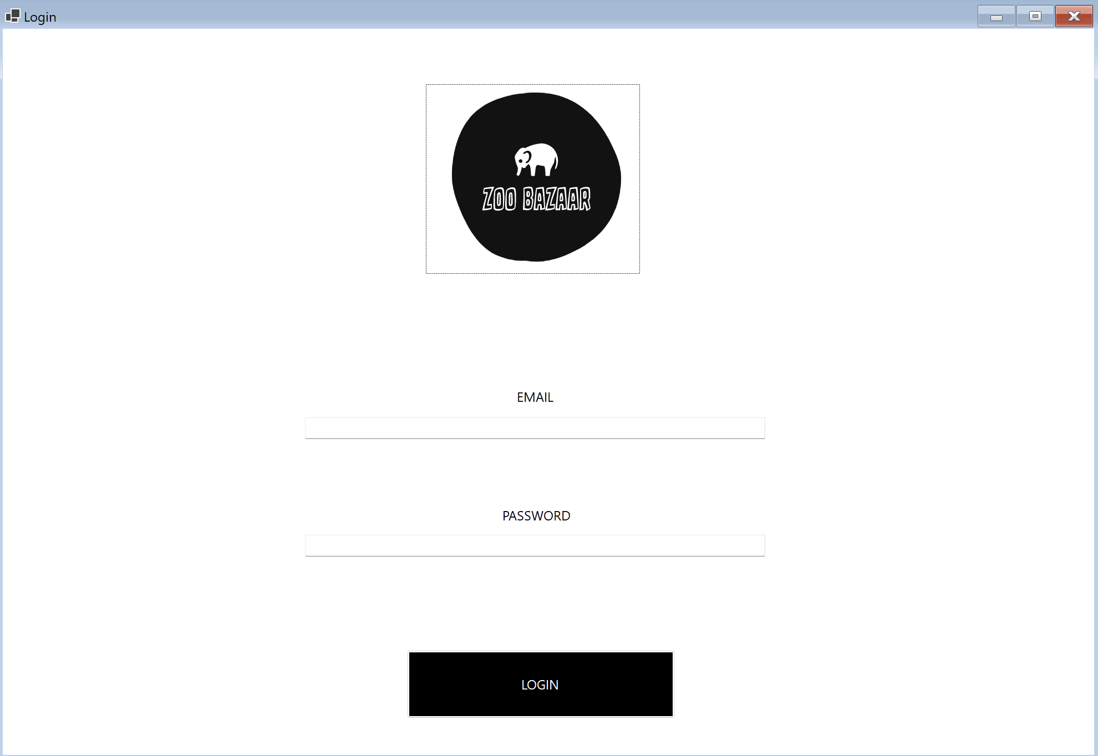
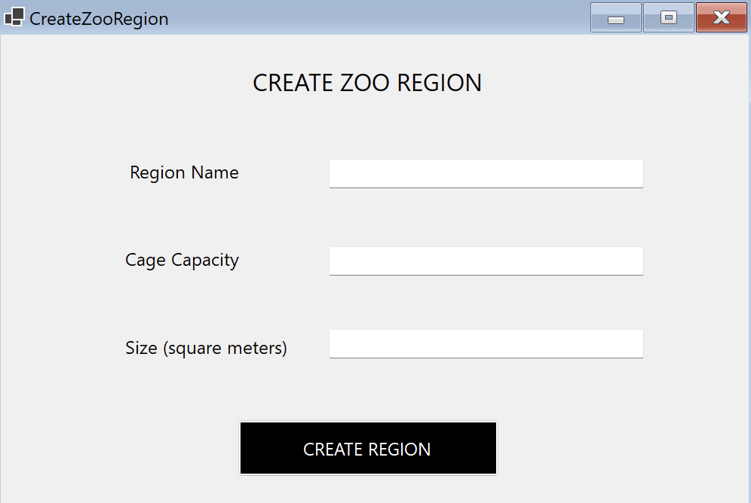
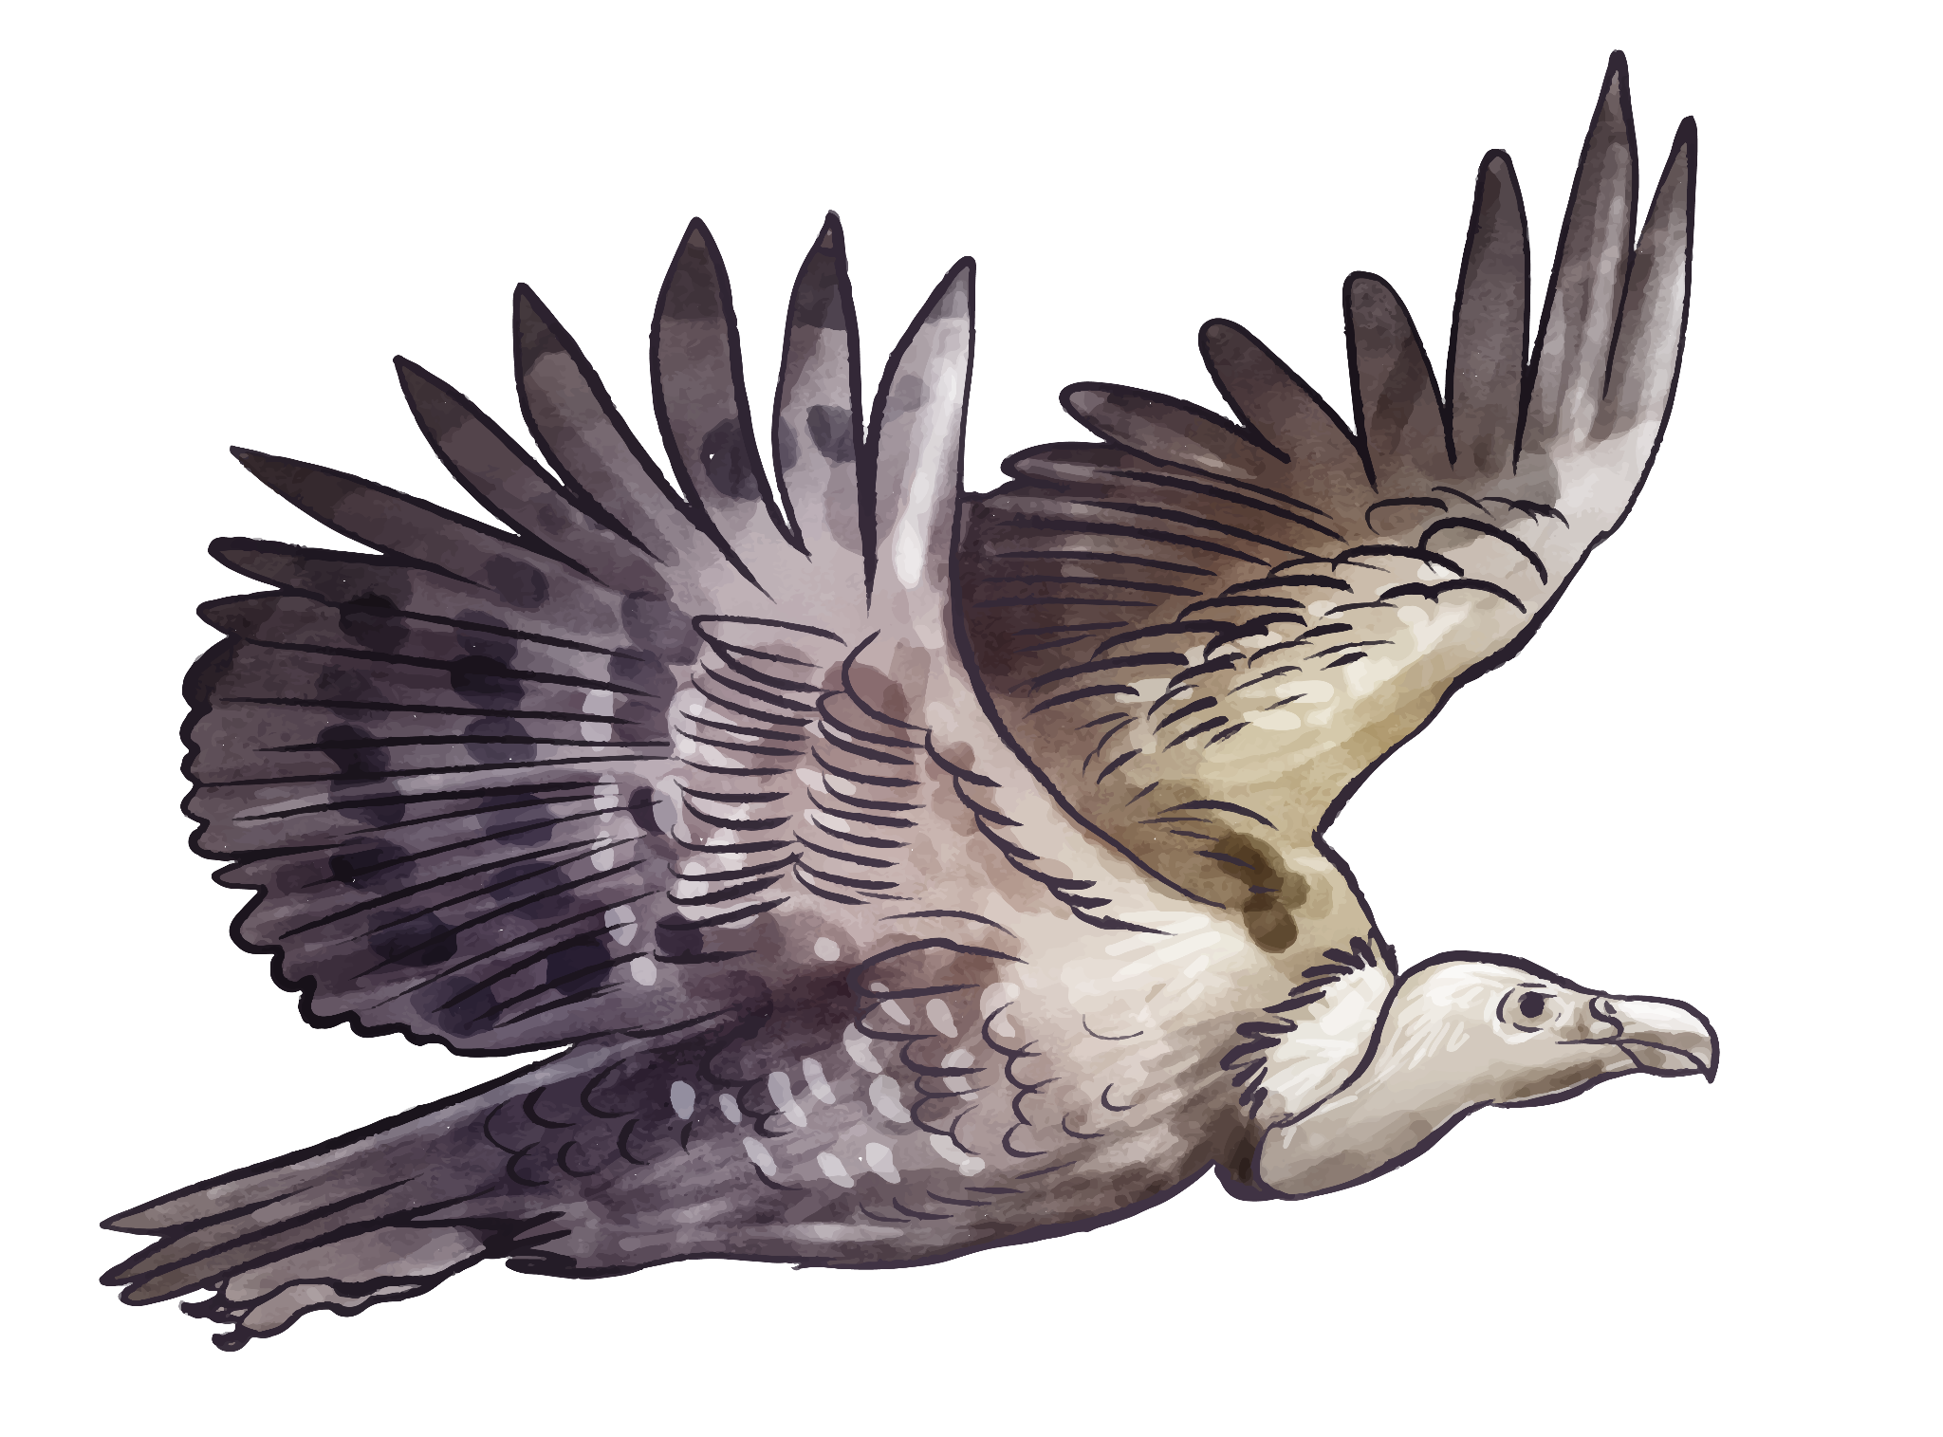
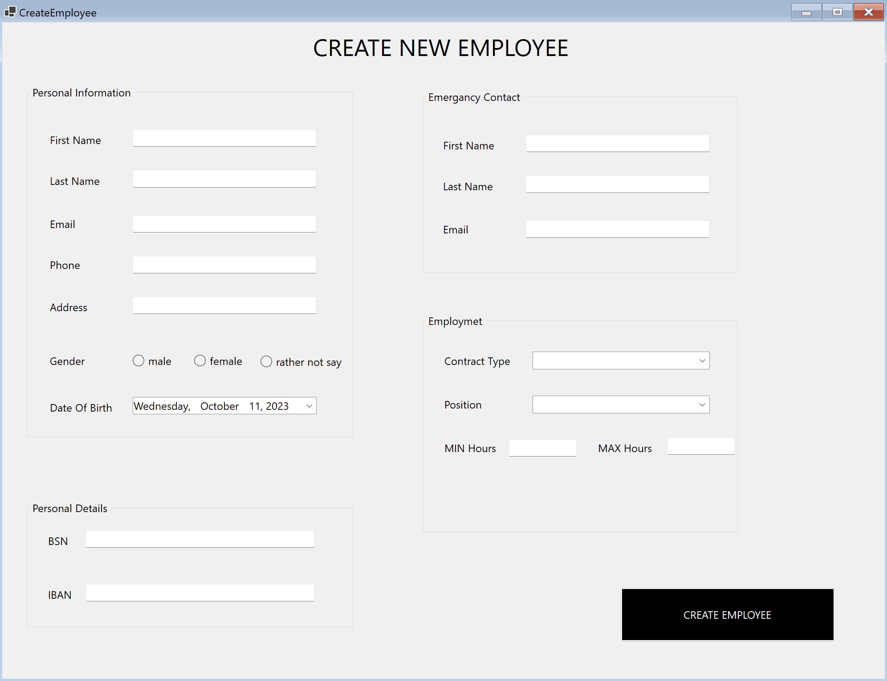

Slide 8
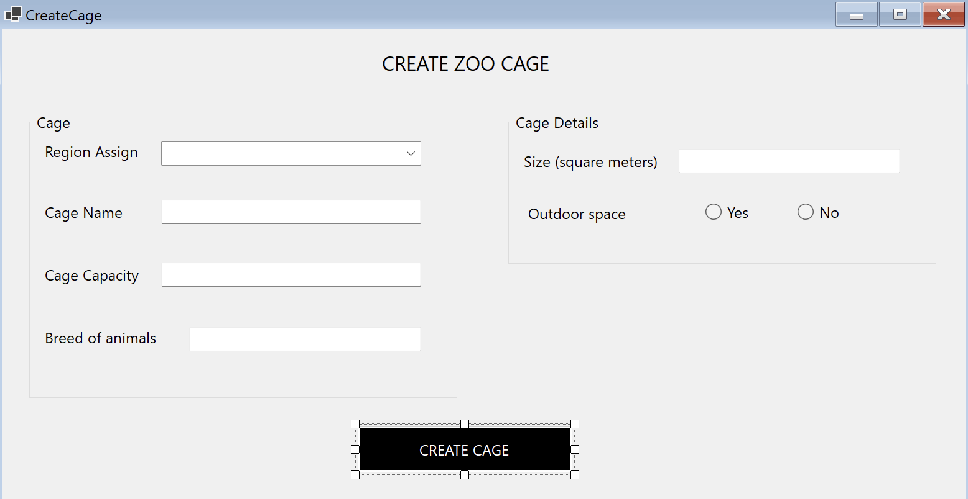
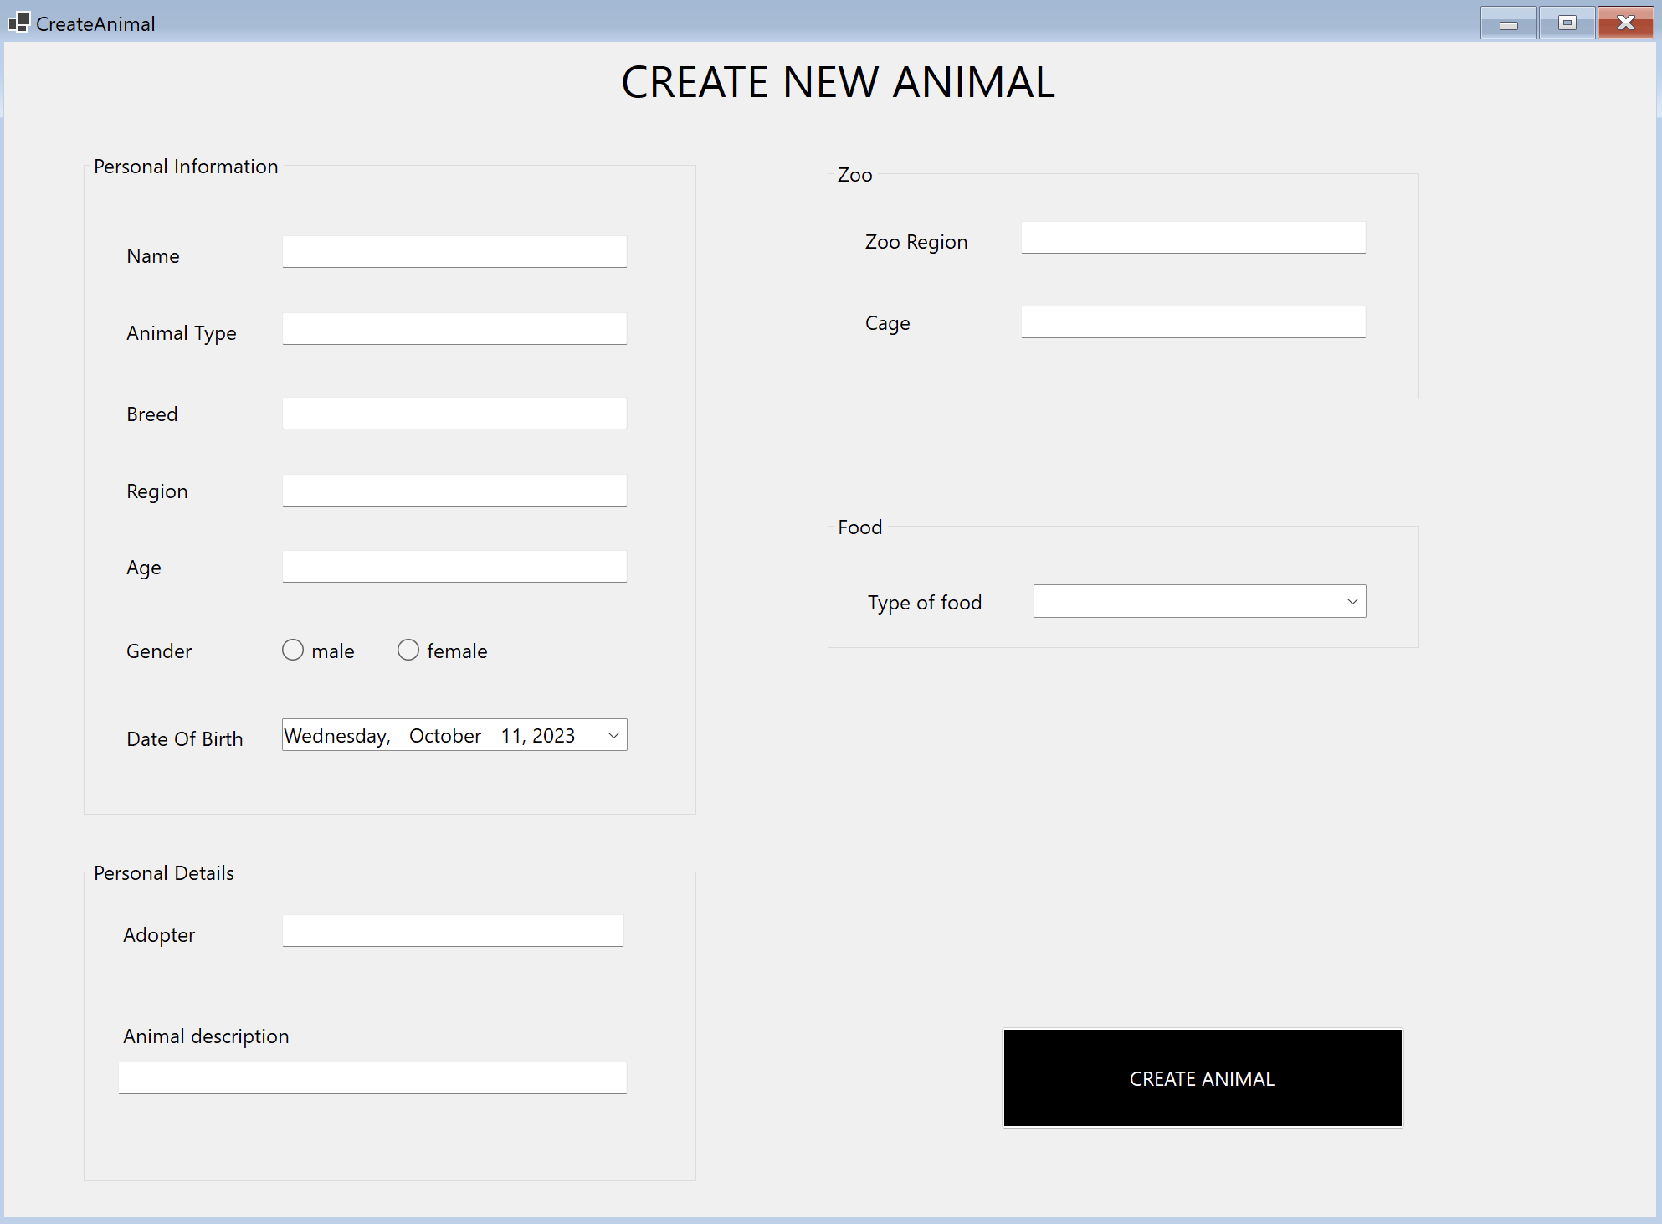


Slide 9



04.
Q&A

Slide 10

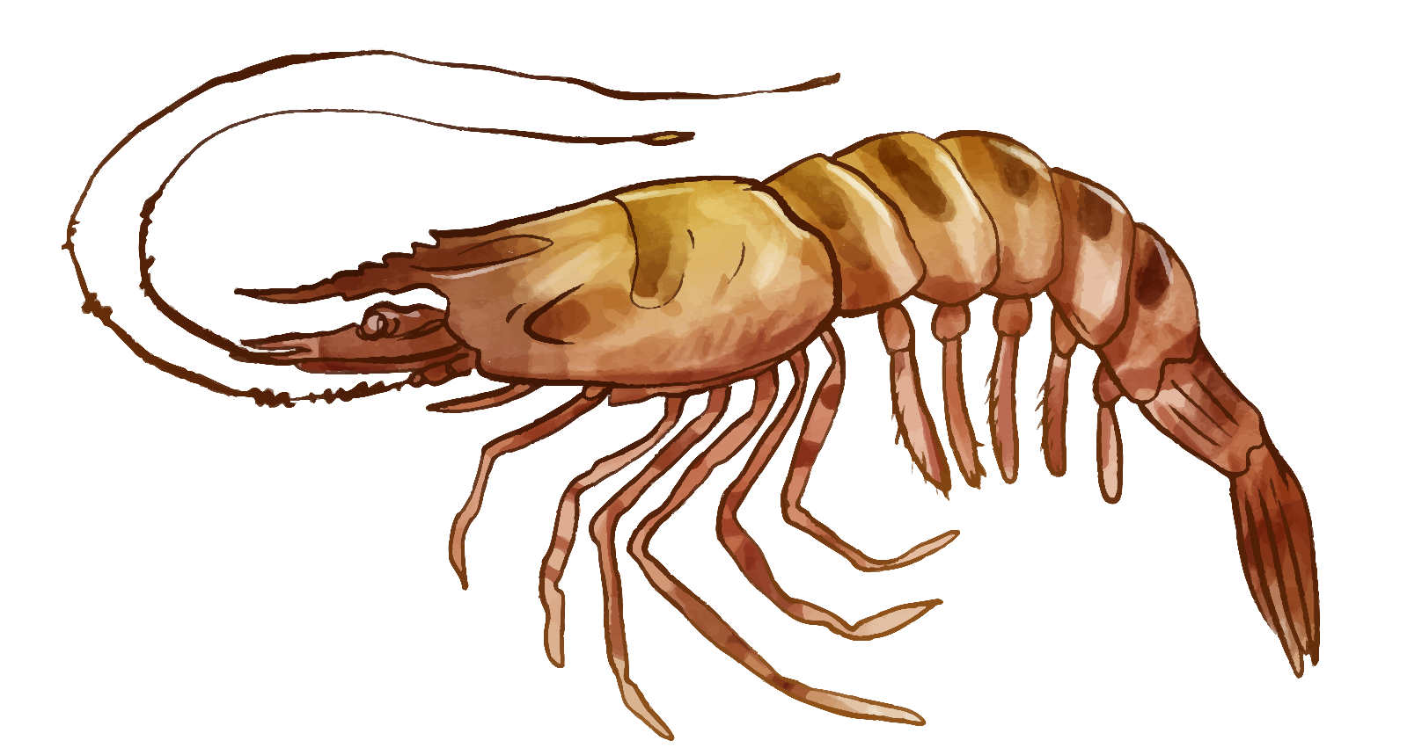
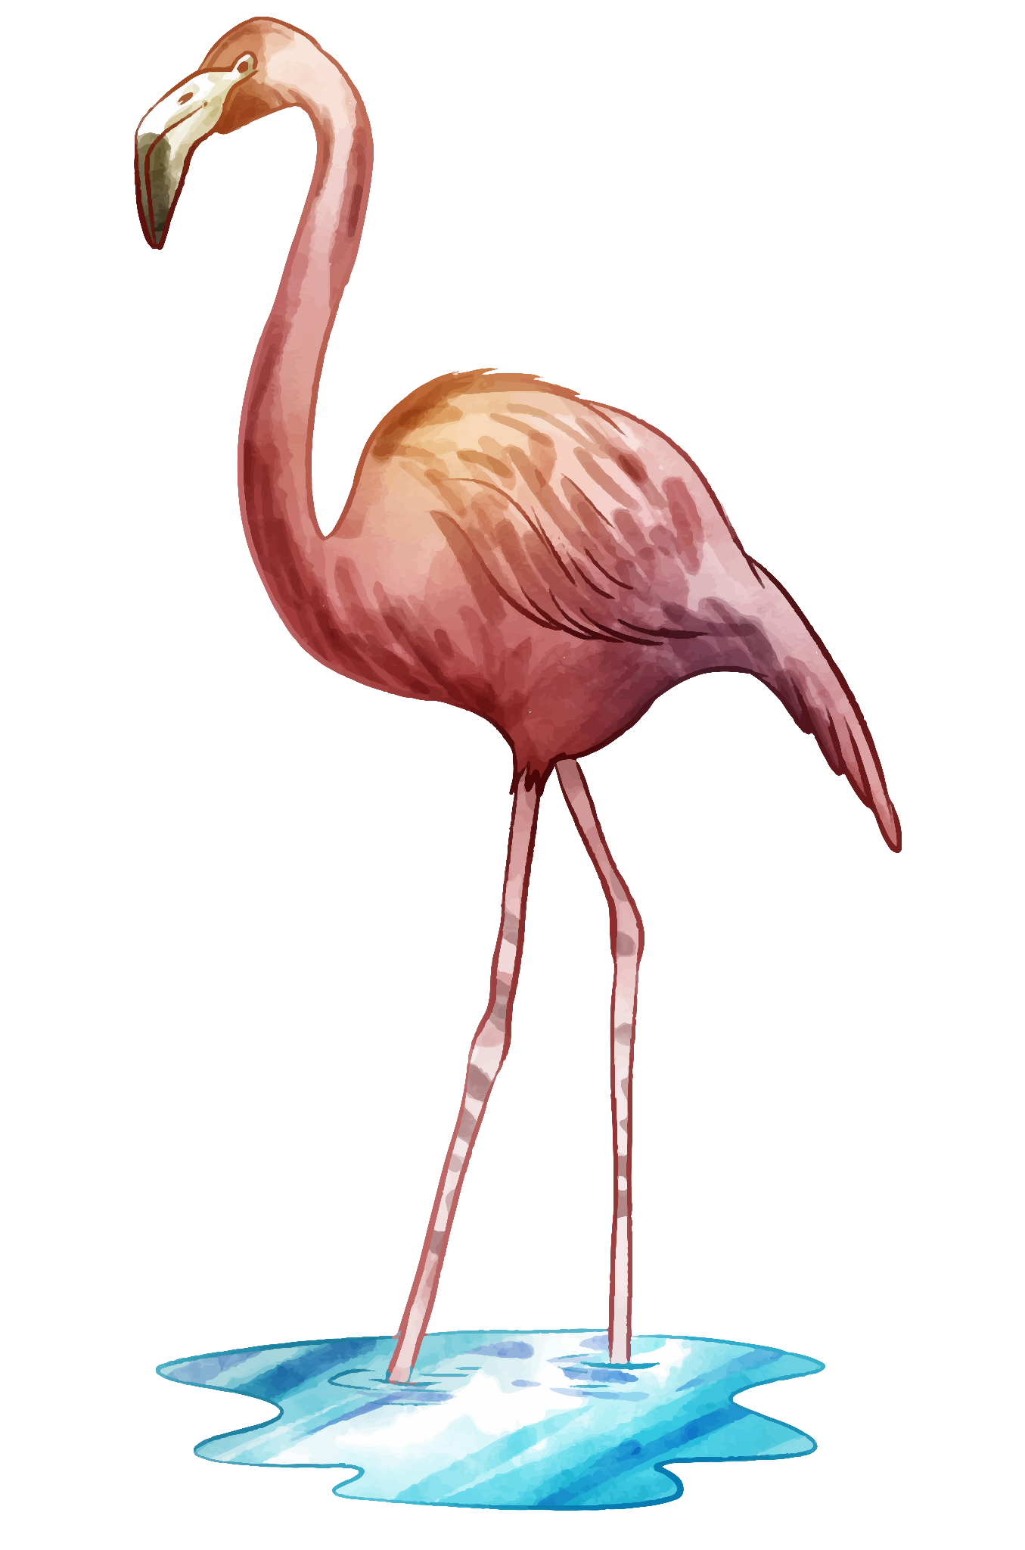
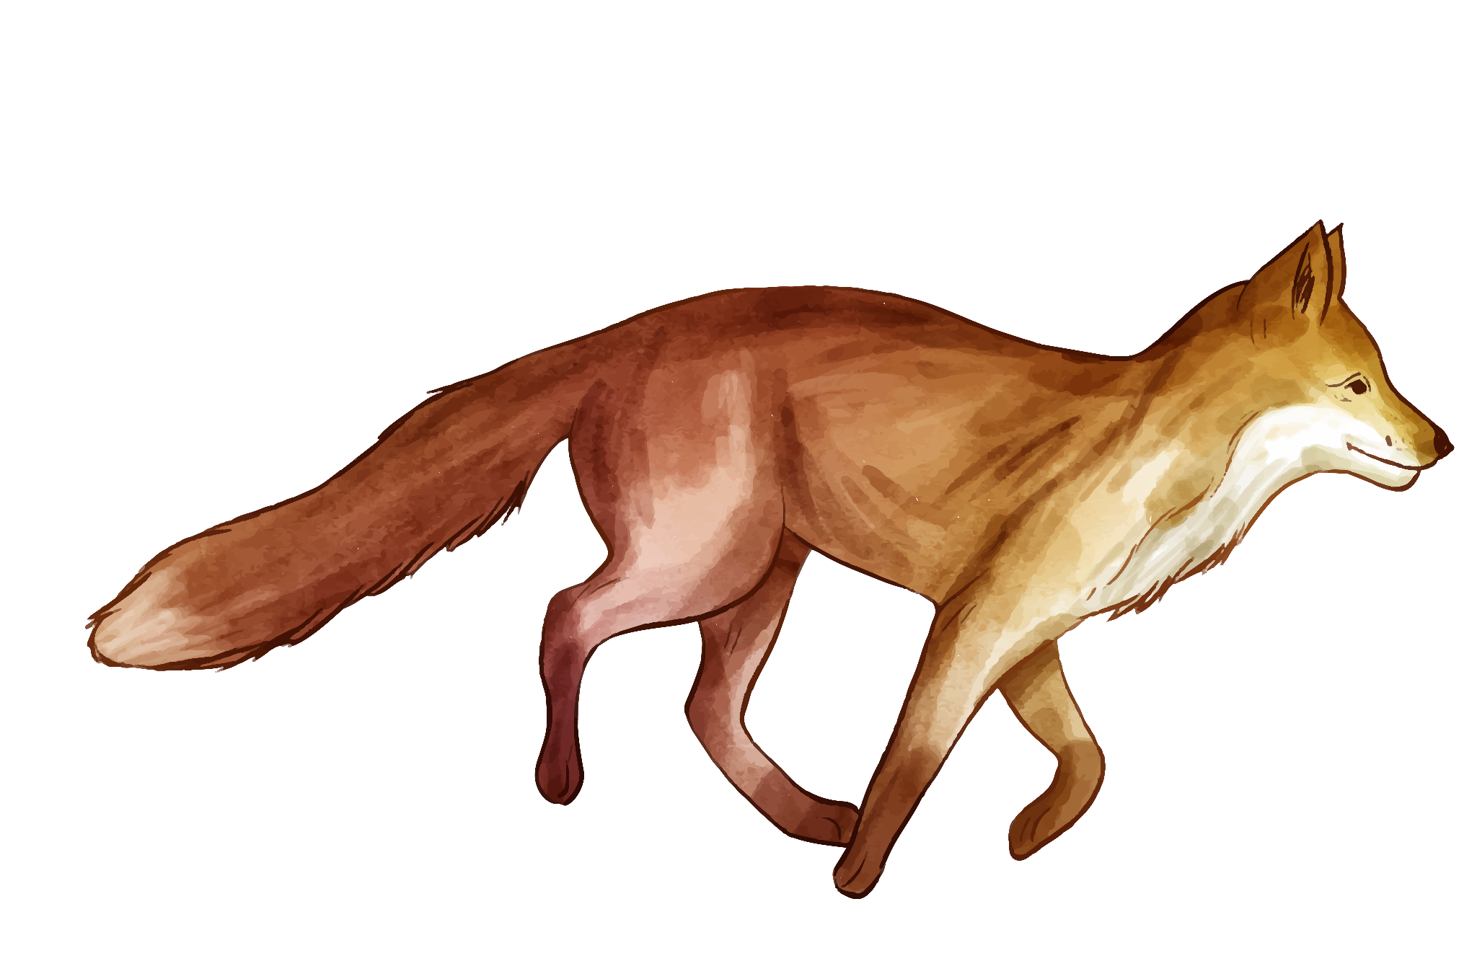

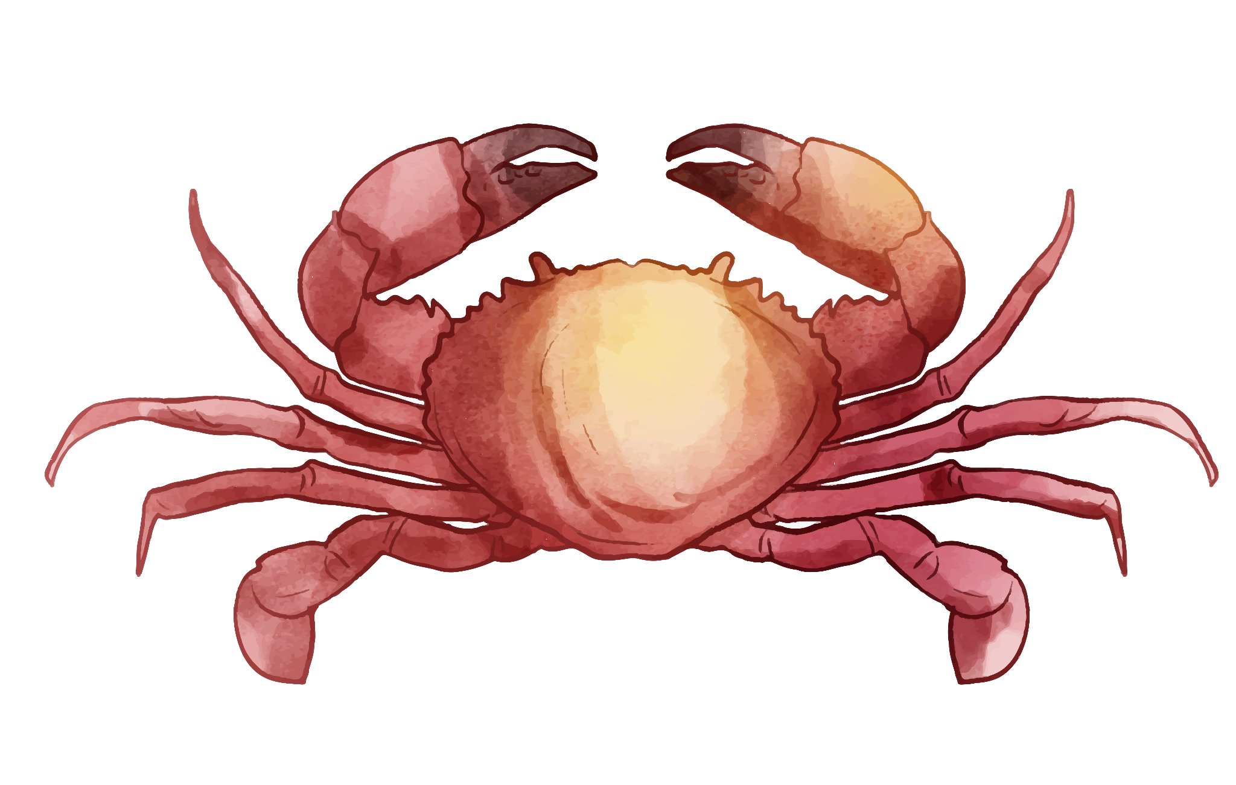
Thank you for your attention!

